Slide 1
Creating Automated Predictive Models using Microsoft Azure
Christopher Rutherford

Slide 2
Overview of Machine Learning in Microsoft Azure
Microsoft Azure is a cloud computing platform that allows data scientists and researchers to create machine learning models
Azure Learning helps reduce the amount of time spent preparing data, training the model, and deploying the predictive model
Many of these processes can even be automated, further reducing the time spent creating machine learning models
We will be using the automated machine learning interface to automate these processes when putting together our model. This allows us to create a machine learning model without typing any code!

Slide 3
Getting started
We will be using Microsoft’s provided guide to set up the workspace: https://docs.microsoft.com/en-us/learn/modules/use-automated-machine-learning/
We begin by signing into https://portal.azure.com/ and creating a new Machine Learning workspace, then entering the workspace we just created by selecting it
After creating the workspace, we select Launch now on the overview page of the workspace
On the left menu bar, select Compute under manage to create new computing resources. We will create a compute instance to test our model and a compute cluster for training the model
More specific details are provided at https://docs.microsoft.com/en-us/learn/modules/use-automated-machine-learning/create-compute

Slide 4
Dataset overview
The data we are using contains clients’ credit card spending/repayment data and comes from the UCI Machine Learning Repository
This dataset determines whether or not clients default on their credit card payments
This contains the following variables:
LIMIT_BAL: Credit card Limit
Age in years
Sex (1 = male; 2 = female)
Education level (1 = graduate school; 2 = university; 3 = high school; 4 = others)
Marital status (1 = married; 2 = single; 3 = others)
PAY_0, PAY_2, PAY_3, …, PAY_6: current and historical repayment status (-1 means paid on time, 1 means 1 month late, 2 means 2 months late, etc.) from April-September 2005
BILL_AMT1, …, BILL_AMT6: amount owed each month (April-Sep 2005)
PAY_AMT1, …, PAY_AMT 6: amount paid towards each month’s balance (April-Sep 2005)
Default payment status (the output/Y variable)

Slide 5
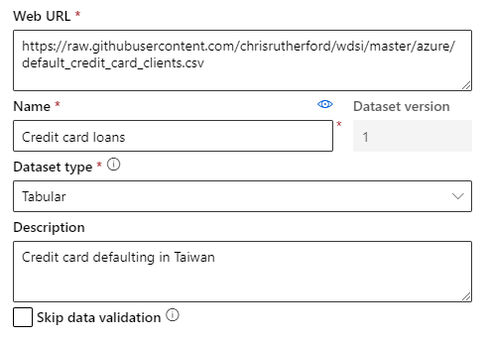
Importing the data
Under Assets, select Datasets and then Create dataset to begin importing the data
Select “web files” to paste a dataset from a URL, or “local files” to upload one from your computer. We will be uploading the web file from GitHub
Set a suitable name and the dataset type to tabular, as we have several rows and columns to make up the table
The data is quite imbalanced, as there are about 2300 negatives (no default) while only about 650 positives (default)

Slide 6
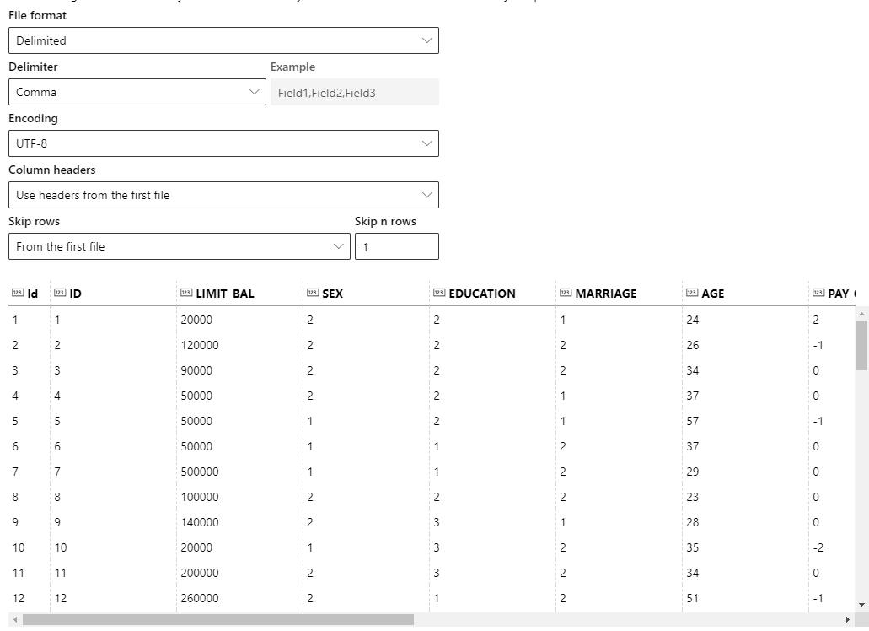
Importing the data cont.
Since we are using a .csv file, we will make our file delimited with a comma delimiter
We use the headers from the first file since we are only importing one file
Since the first row of this particular file contains an extra row of headers (X1, X2, etc.), we will skip it and use the row with actual names for our headers
We have a convenient preview to make sure that the data is being imported correctly
We can see each column’s header along with the values in each column

Slide 7
Training the models
Once our dataset is ready, we can start training our model by selecting Automated ML in the Author section of the menu on the left
We select our dataset from the list provided, giving it a suitable name - I simply called mine “ccdefault” - and select the proper target column. In this dataset, the target column is “default payment next month”
The target column is the variable we are predicting. In this case, we want to predict a binary outcome - whether or not a customer defaults, so for task type, we select classification
For classification, the primary metric it uses defaults to accuracy, but we can look at more detailed metrics after the models are done training
Depending on the dataset size, training can take several minutes. While the models are training, you can view the progress on the Models tab

Slide 8
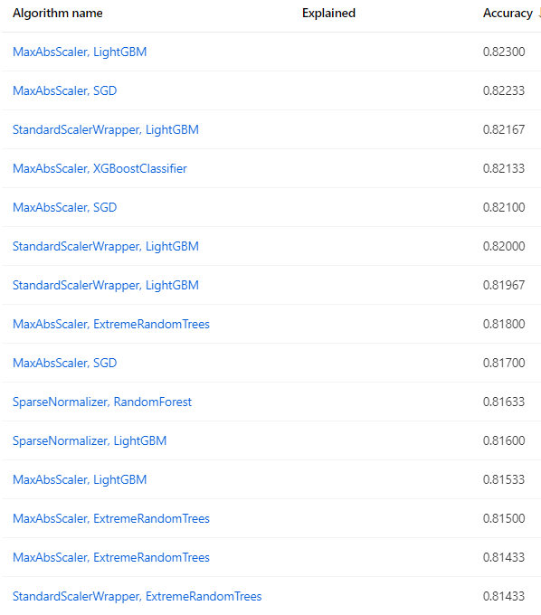
Evaluating the models
Once the models have finished training, we can go to the Experiments tab and select the session we just ran
By default, the models are sorted by accuracy from highest to lowest. We will select the first (most accurate) model
MaxAbsScaler scales down the data to the range [-1, 1] based on the largest absolute value of the original data. A smaller data range helps speed up model training
LightGBM (light gradient boosting machine) is a gradient boosting framework by Microsoft that is based on the gradient boosting decision tree machine learning algorithm, but is optimized for significantly faster computation with identical or even improved accuracy
We can click on the model name, then select “Metrics” to get a more detailed look at its performance

Slide 9
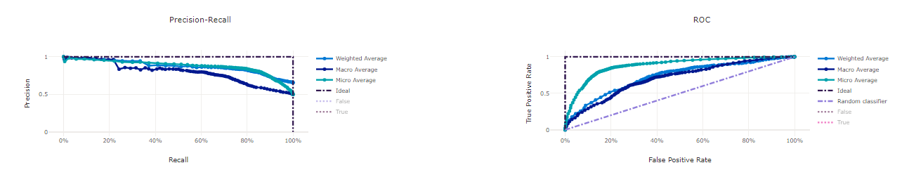
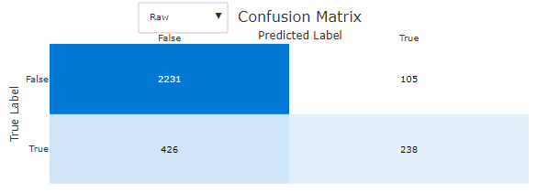

Evaluating the models cont.
The metrics page provides us with a variety of model performance metrics and curves
Since we are performing binary classification, we are particularly interested in the ROC AUC, precision and recall, accuracy, F1 score, and confusion matrix
While it is important to focus on and optimize one metric, only one metric usually cannot tell the entire story, so we use a handful of important metrics to gauge our model’s overall performance

Slide 10
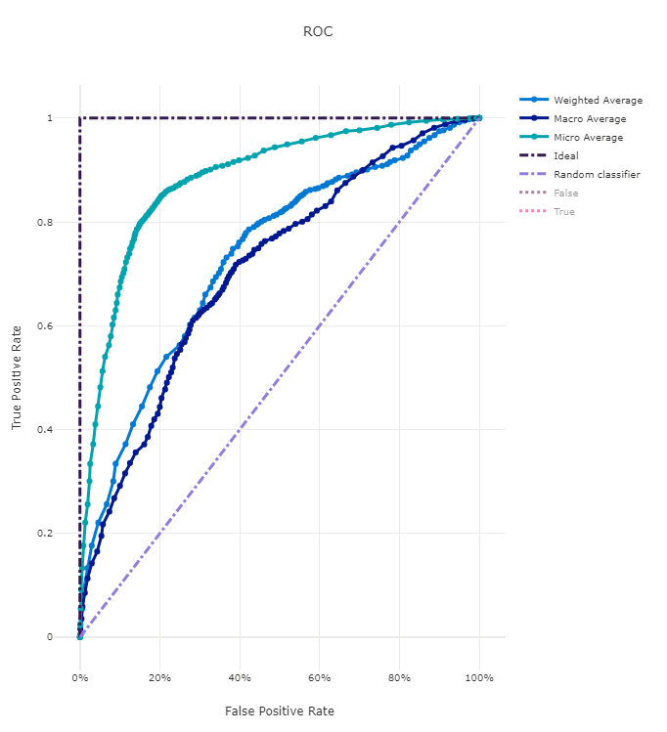
Evaluating the models: ROC AUC
ROC AUC stands for “receiving operator characteristic, area under the curve”
This curve plots the false positive rate against the true positive rate at different decision thresholds
The closer to the top left, the better the model performance. An AUC of 1 is perfect while an AUC of 0.5 is the same as randomly guessing
This model’s performance is adequate, with a weighted AUC of 0.78

Slide 11
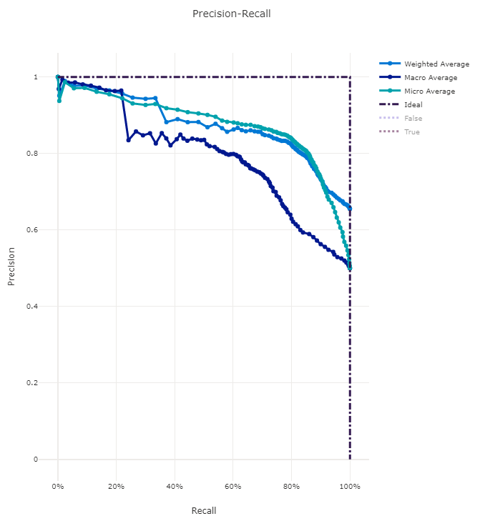
Evaluating the models: Precision-Recall
The Precision-Recall curve is particularly useful for models that have class imbalance, such as the one we are working with
This curve plots the precision and recall rates at different decision thresholds
The closer to the top right the curve is, the better the model performance. An AP (average precision-recall) of 1 is a perfect model. This model attained an AP of 0.76
Precision is defined as # of true positives divided by the sum of the # of true and # of false positives
Recall is defined as # of true positive divided by the sum of # of true positive and # of false negatives

Slide 12
Evaluating the models: Confusion Matrix
The confusion matrix provides a simple and convenient way to see how the model classified/misclassified the data
For instance, the top row tells us that 2231 data points were correctly labeled as false (no default), while only incorrectly predicting 105 of the non-defaults as defaults
The bottom row tells us 426 defaults were incorrectly classified as non-default, and 238 defaults were correctly classified as such
The model may be biased towards classifying people as non-defaulting simply because it is the majority class. Additionally, outside factors, such as economic health or personal financial hardship, which are not in our data/model can influence a person’s default outcome

Slide 13
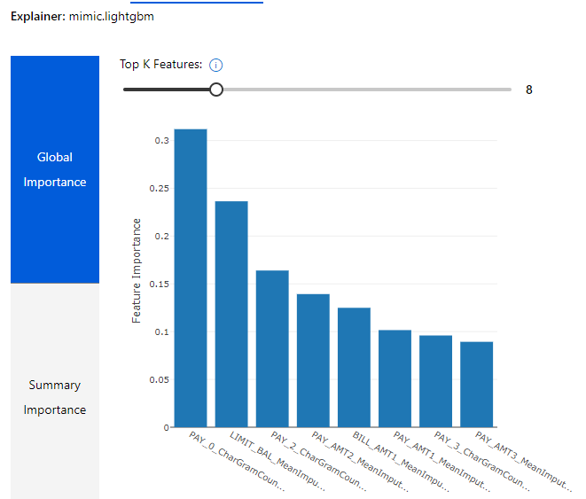
Evaluating the models: feature importance
In order to figure out which X variables were the most important/useful for predicting credit card defaults, we select “Explain model” and allow that to run, then go to the “Explanations” tab once it is finished
From this chart, we can see PAY_0 is the most important feature in our classifier, with LIMIT_BAL a close second
LIMIT_BAL and some of the other variables have “MeanImputer” appended to them as these columns may have had missing values. These missing values were filled in (imputed) with the mean of the column

Slide 14
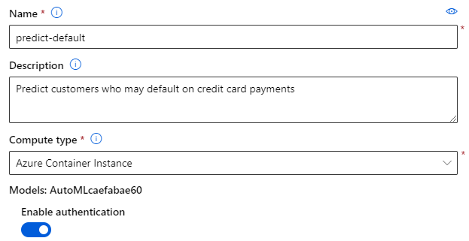
Deploying the model
Once we are satisfied with our model, we can click “Deploy” to deploy the model we selected to create predictions
Use suitable names and descriptions for the data. Select “Azure Container Instance” for compute type and enable authentication
Now just click Deploy and let Azure take care of the deployment
Under the “Model” tab, the Model summary box displays the progress of the deployment

Slide 15
Deploying the model cont.
Once the model has successfully deployed, go to the Endpoints page from the navigation menu on the left, select the one we just made, then select Consume at the top - we need the REST endpoint and primary keys to connect to the model
Next we head to the Notebooks page and create a new notebook called default_test with file type Notebook. Create it and let the notebook connect
A block of code is provided that we will copy and paste into the notebook, adding our keys from the deployed model
We just need to change the values in the X variable to look like values of credit card customers and predict if they will default, but otherwise the rest of the code is unchanged

Slide 16
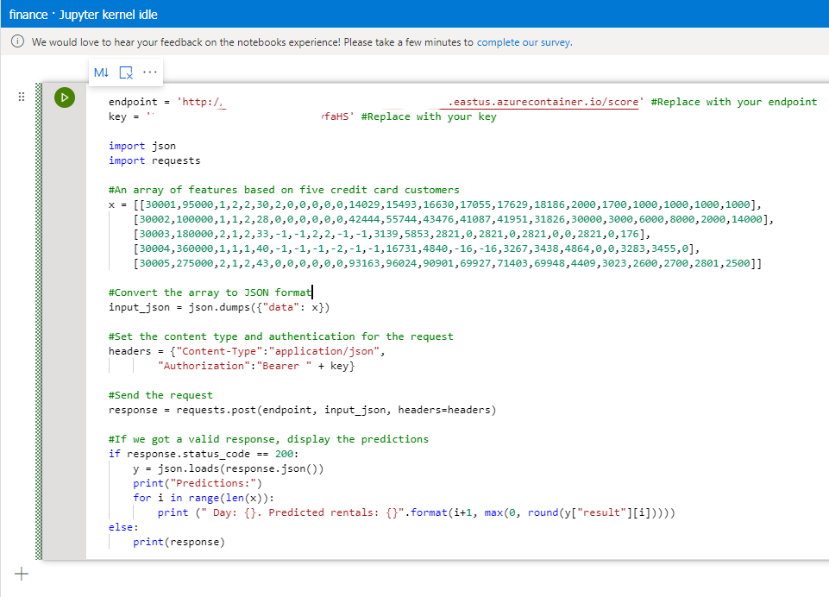
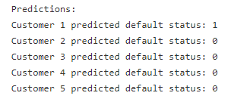
Testing our deployed model
The notebook page should be identical to the screenshot on the right (my keys are whited out)
Once the notebook is prepared, we just save it and click the green start button on the left
The output in the print statement can be adjusted to reflect your data, but this will not change the actual predictions (it is optional!)
After running, you should be presented with output for your predicted values
Our model predicted 1 default and 4 non-defaults
And that’s it! The entire model has been created from start to finish with no knowledge of code necessary

Slide 17
Knowledge Check
1. An automobile dealership wants to use historic car sales data to train a machine learning model. The model should predict the price of a pre-owned car based on characteristics like its age, engine size, and mileage. What kind of machine learning model does the dealership need to create?
Classification
Regression
Clustering
2. A bank wants to use historic loan repayment records to categorize loan applications as low-risk or high-risk based on characteristics like the loan amount, the income of the borrower, and the loan period. What kind of machine learning model does the bank need to create?
Classification
Regression
Clustering
3. Which of the following types of machine learning is an example of unsupervised machine learning?
Classification
Regression
Clustering

Slide 18
Knowledge Check: Answers
This would be a regression model, as the dealer is using continuous, numeric data to predict the value of a continuous, numeric output.
This would be classification, as the bank has two specified classes - low-risk and high-risk - to assign to their clients based on other features.
This would be clustering, as the actual label/value of the output is not known. In clustering algorithms, data points are grouped together based on how similar they are to one another; they are not assigned a specific target class like they would be in supervised classification models.

